Slide 1
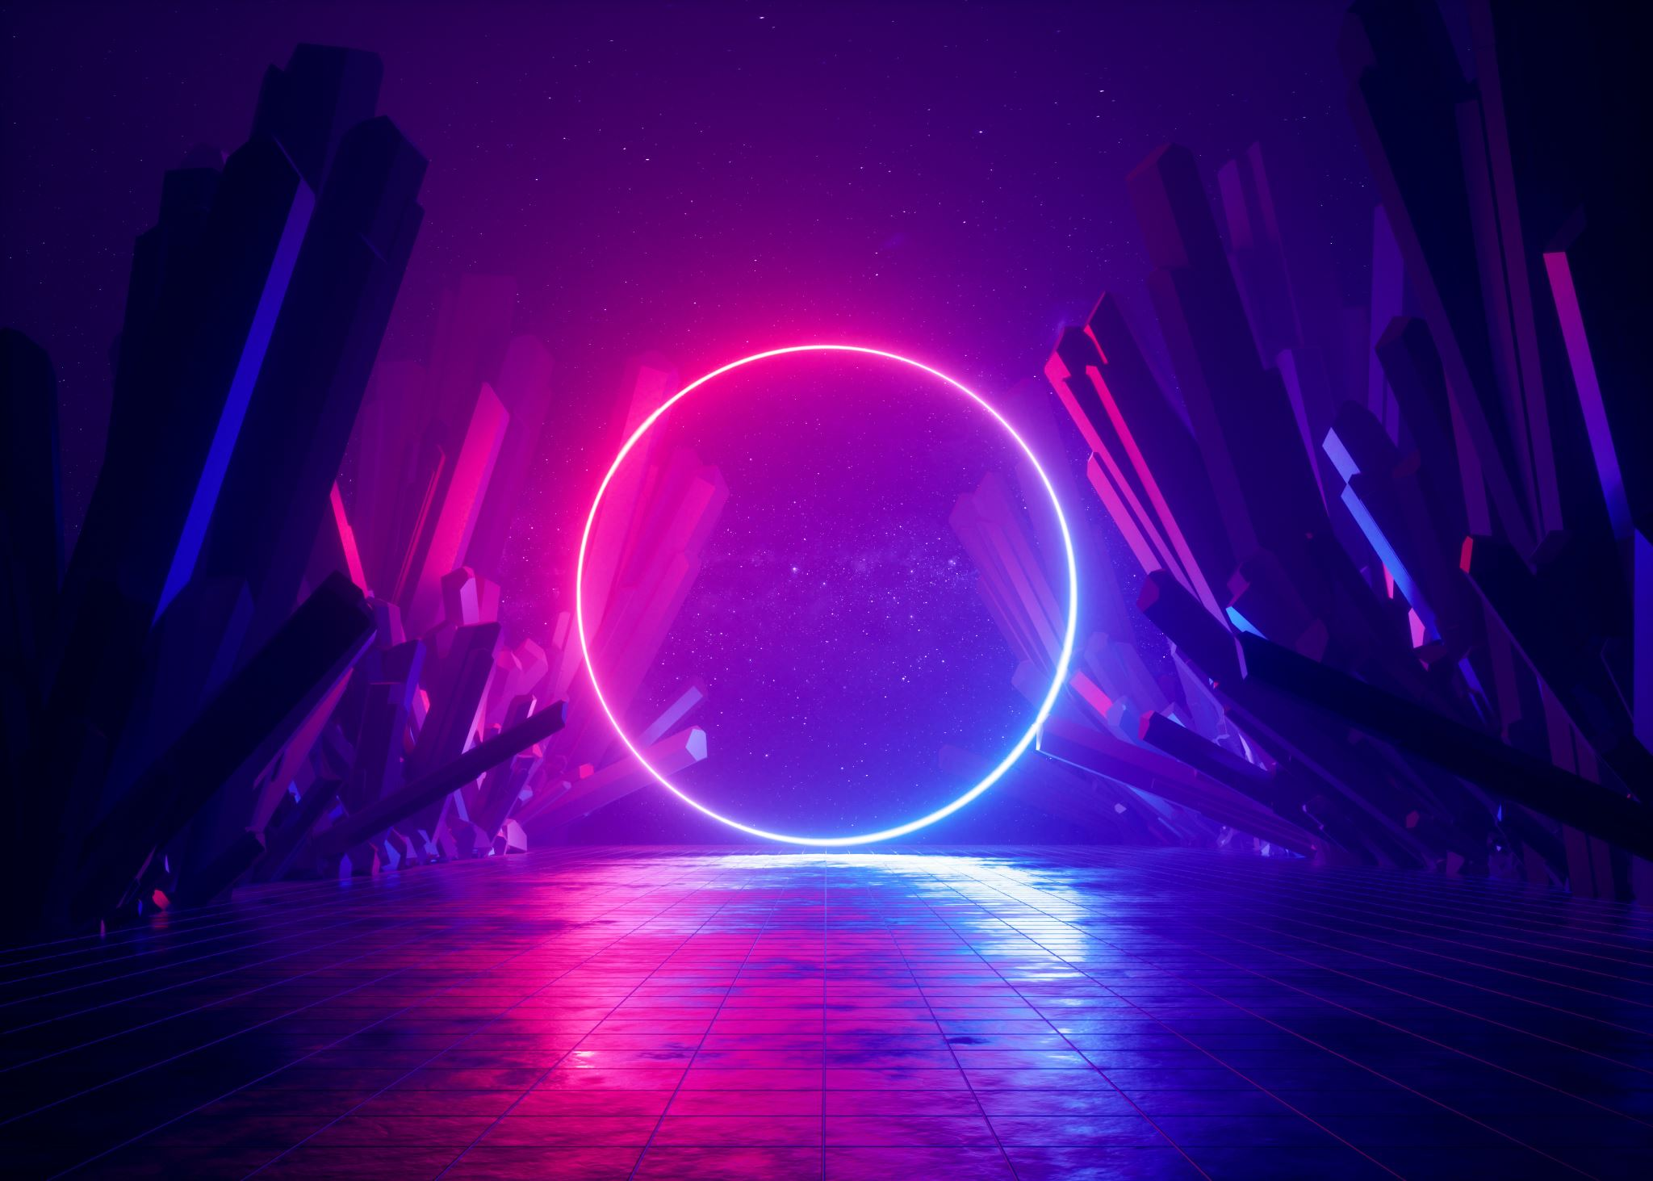
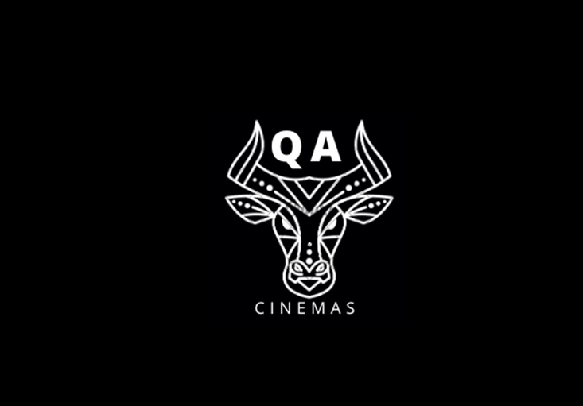

Slide 2

INTRODUCTION
Emily Bradfield, Shahmeen Shaikh, Ibraheem Latif, Michael King, Madeha Rawshon, Jabril Yusuf.
We have created a full-stack web application for a QA cinema. The web app had to have frontend-backend functionality for booking tickers, contacting the team and a forum page. The site also needs to have information on the cinema and the movies being shown.
We used an agile workflow to build a web application from the ground up. Each member of our team had an input in each part of the application to ensure we all had experience in back-end and front-end.
Who are we?
What have we done?
How have we achieved this?

Slide 3

CONCEPT
Planned our project on a Kanban board using Jira software
Decided on a layout for our front-end
Planned to use techniques and new technologies taught to us in prior learning, implementing them into our project
Used the story points from our Jira board to prioritise

Slide 4
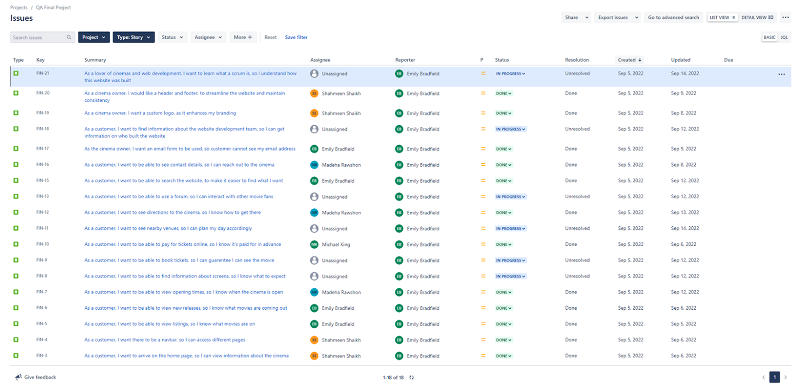
Sprint Plan

Slide 5
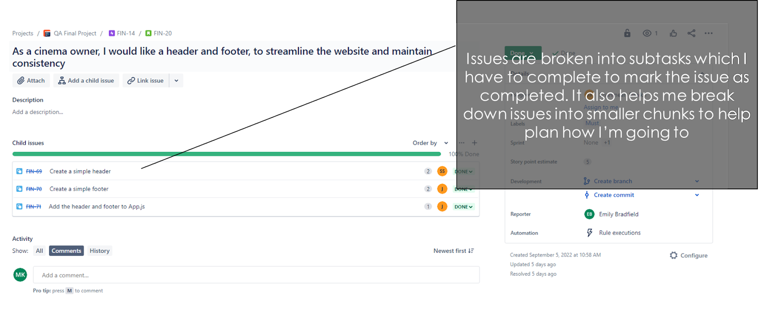
Sprint Plan

Slide 6
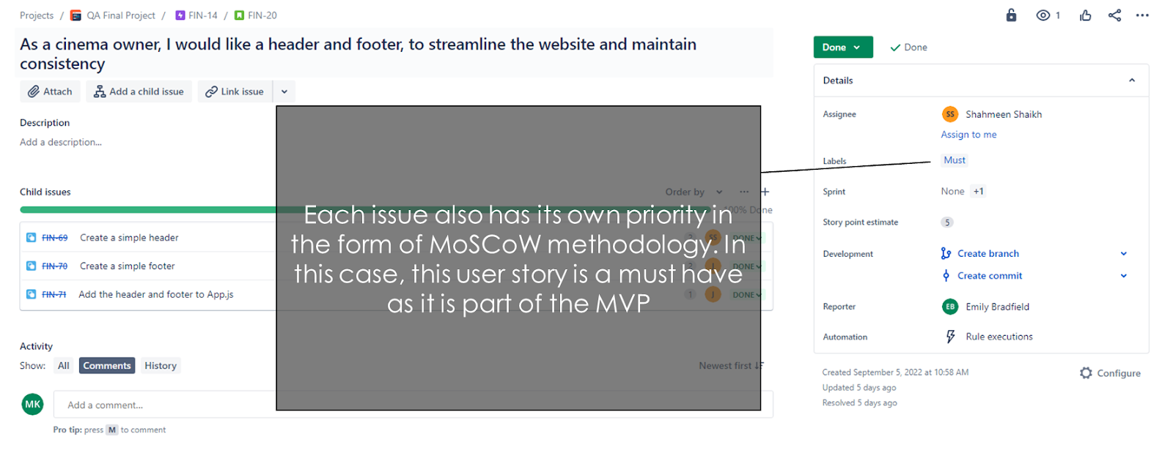
Sprint Plan

Slide 7
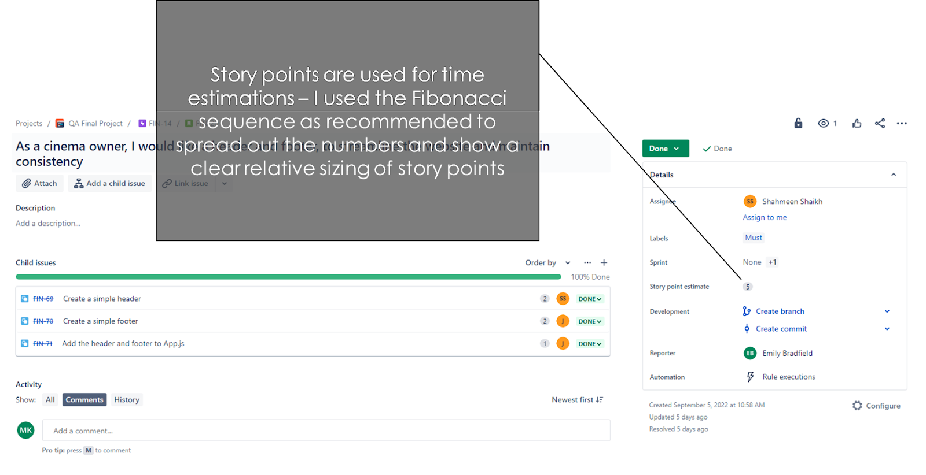
Sprint Plan

Slide 8
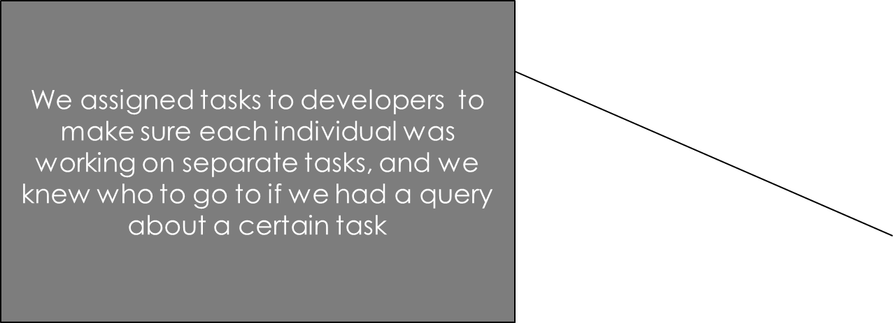
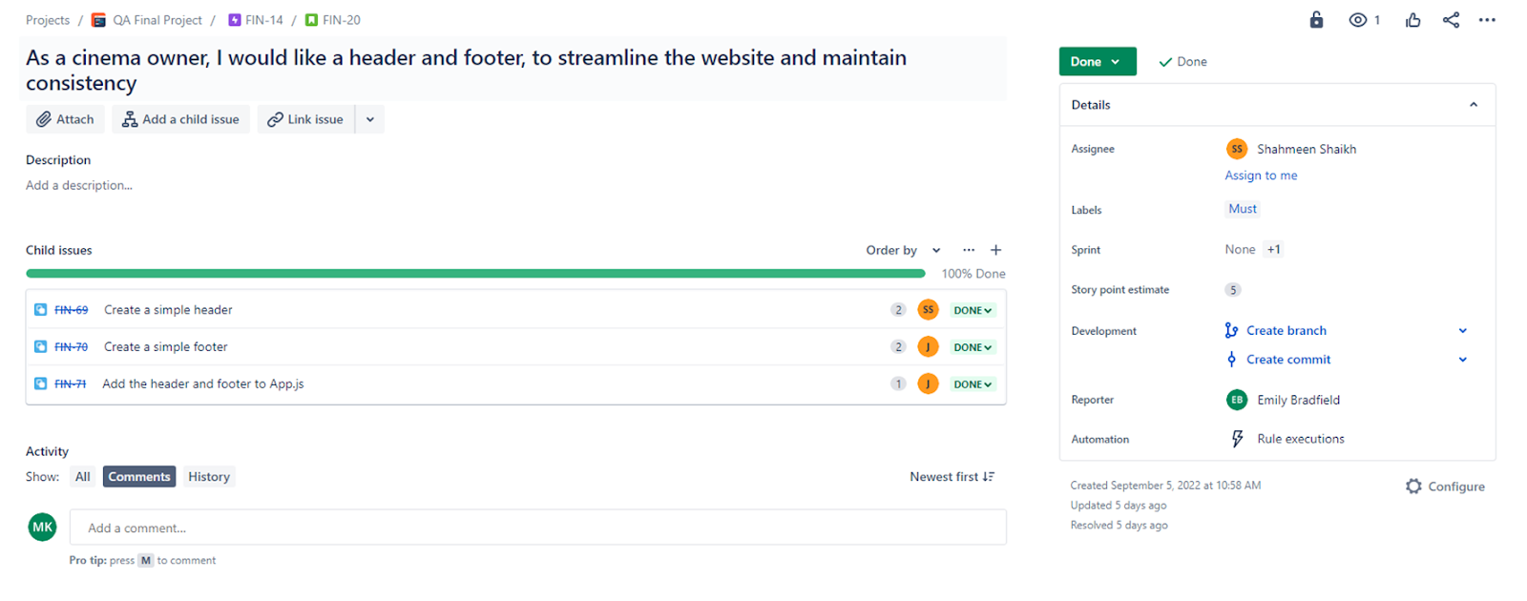
Sprint Plan

Slide 9




TECH STACK
MongoDB - Document-oriented non-relational database
Express - Server-side web framework that implements middleware into a project alongside Node
React - A popular client-side JavaScript framework used to create dynamic user interfaces
Node.js - Provides a backend JavaScript runtime environment
HTML, CSS and JavaScript are the three main languages used in frontend web development
Chai is an assertion library that works alongside Mocha, a Node.js testing framework

Slide 10




BACKEND
Final Deliverable: Our final product must be able to allow users on the front-end to navigate through our web application to see all our information pages. They should also be able to use the bookings, contact and forums page to send data through the UI, into our API and finally into our three collections in our online MongoDB database.
Collaboration: From the first day of development, I worked closely with my colleagues to ensure our separate routers and models had the same foundation. We helped each other with any bugs we had so we could finish our work quicker.
Git: Our development team actively used git as version control to keep our work updated and tied. We used a feature-branch model for organisation and security, so any extra features we had are separate from the main, saved work-load and can be merged manually whilst checking for any conflicts in the code.

Slide 11



BACKEND
Challenges:
One of my main challenges I faced was the implementation of my ticket limitation for each screening. I made the decision to work out total tickets for each screening in an array instead of a database, as it wouldn’t involve any further back-end involvement. In doing so, I quickly found that the logic behind doing this would include multiple nested if-statements and loops, in which I easily lost track of where I was, and spent a long time debugging to find out where I went wrong.
Another challenge I faced was implementing the reply functionality for each forum message. I had to try to reverse-engineer an HTML page element by looking through hundreds of lines of properties to find a way to reference other elements relative to one I was looking at.
What am I proud of?
I’m proud of my dedication and commitment to every challenge I faced. I’d be able to use problem solving to debug my work, then understand exactly why it went wrong. Having this understanding of how each component worked helped me work more efficiently, and with less chance of creating bugs further down the line.

Slide 12

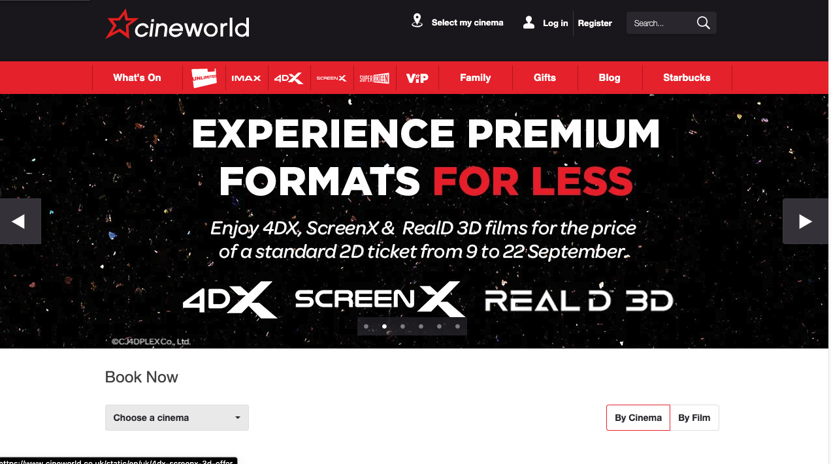
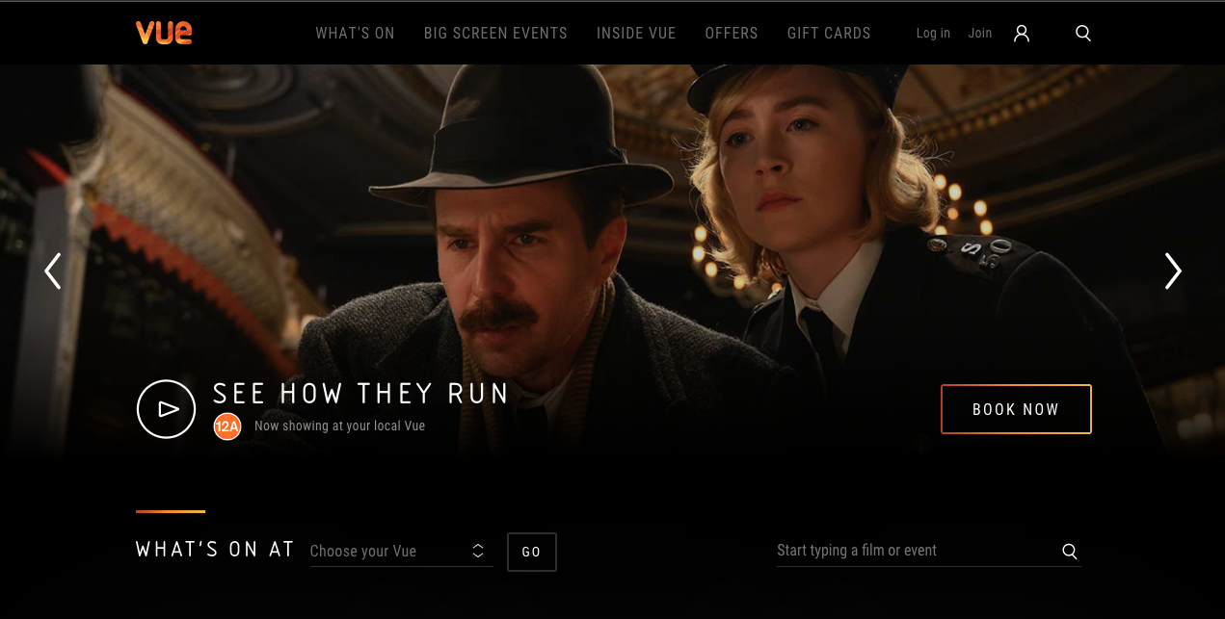
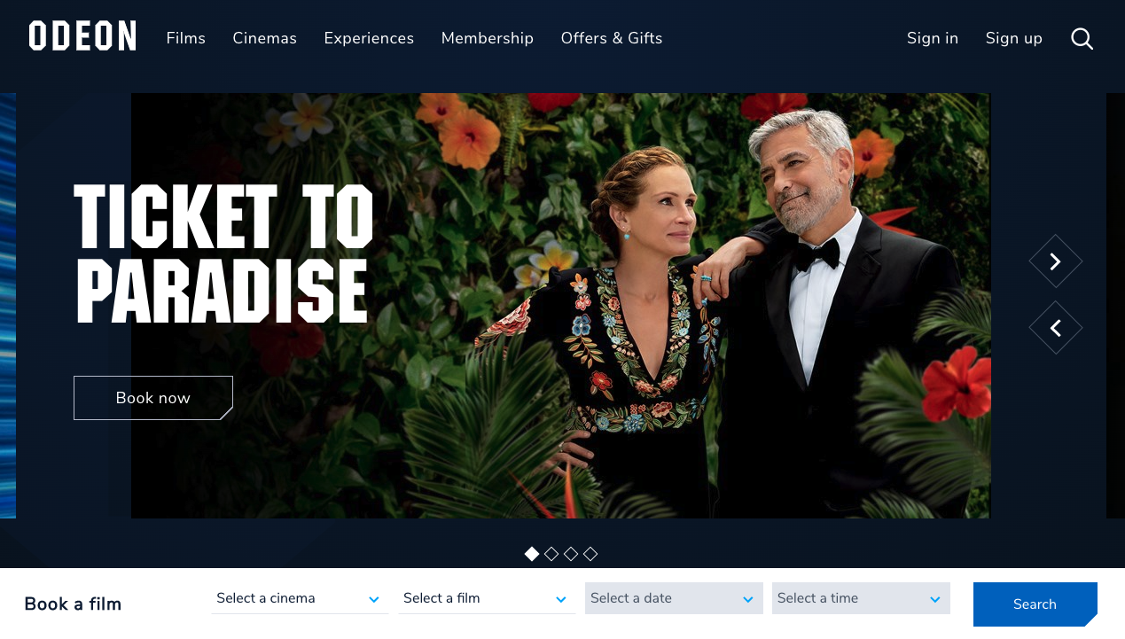
CREATION OF QA CINEMAS BRAND Initial research phase
Cinema branding
Generally dark colour theme
Bold font
Cinema Websites
Minimal design
Easy navigation

Slide 13

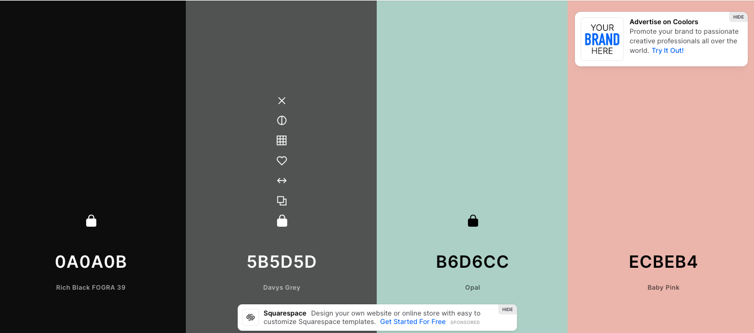
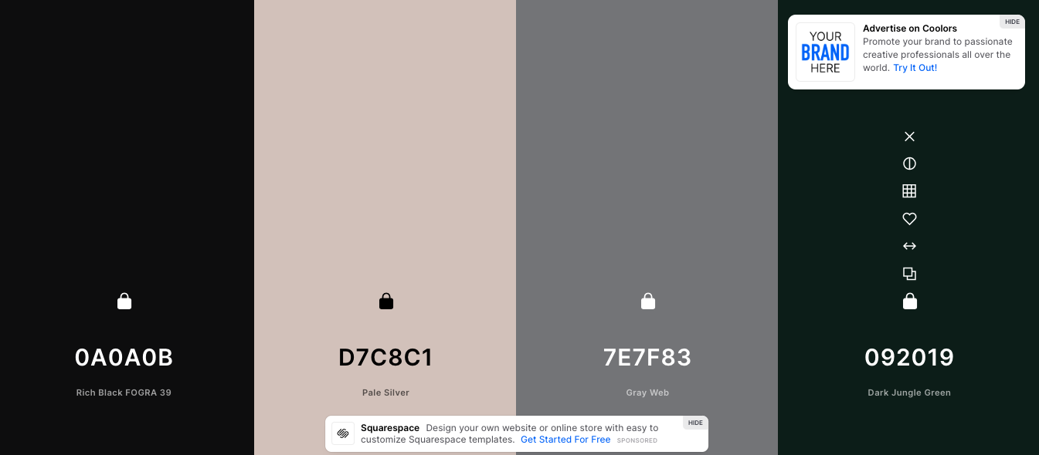
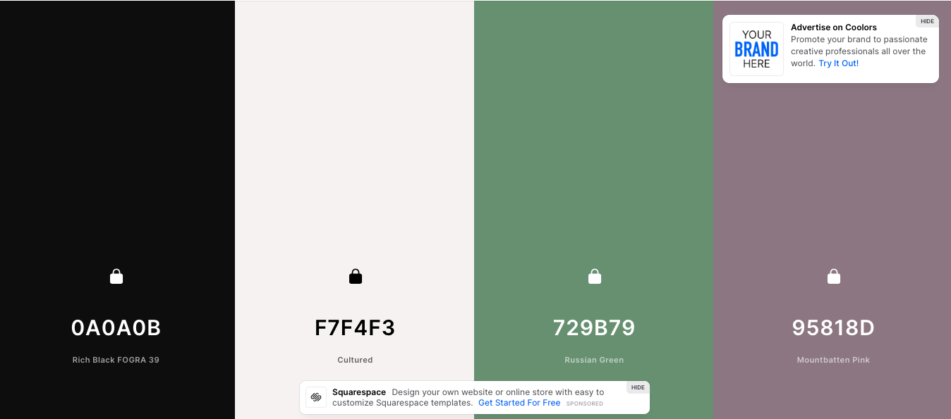
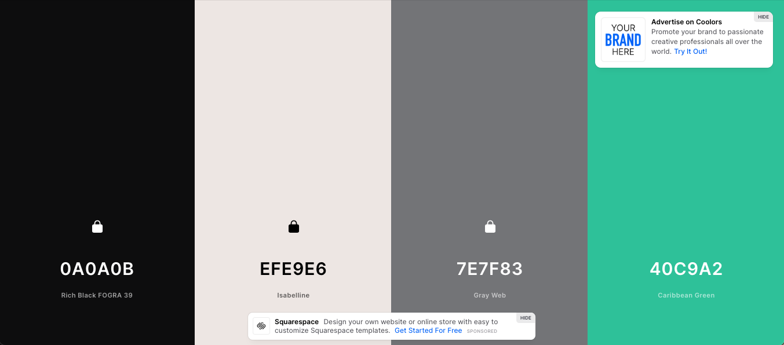
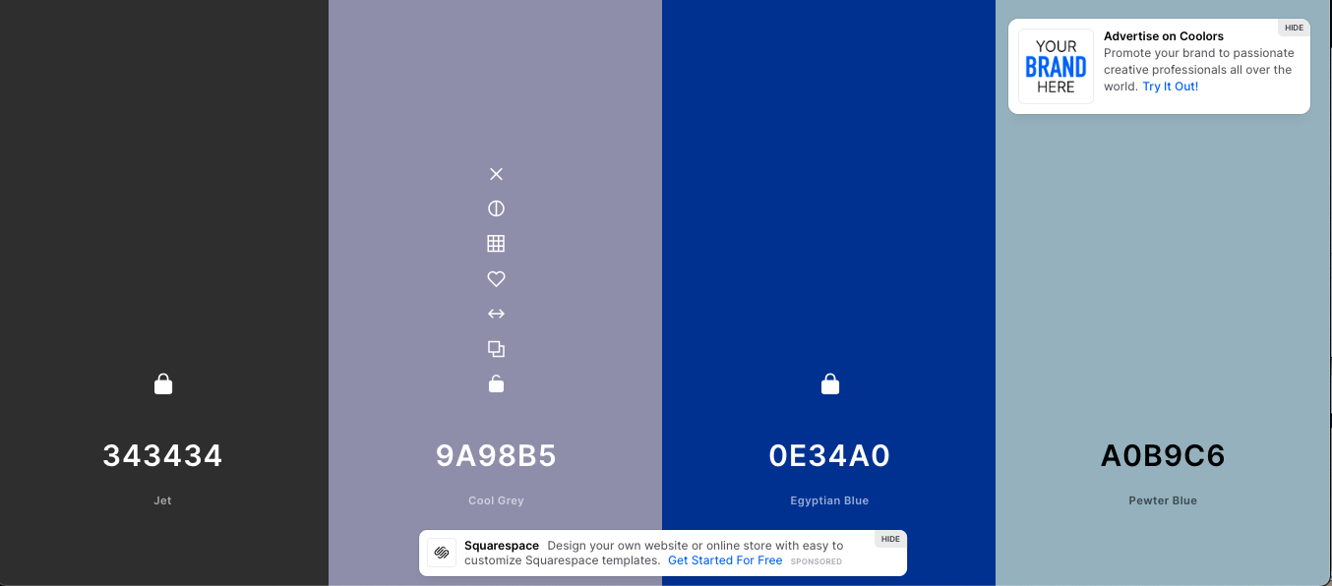
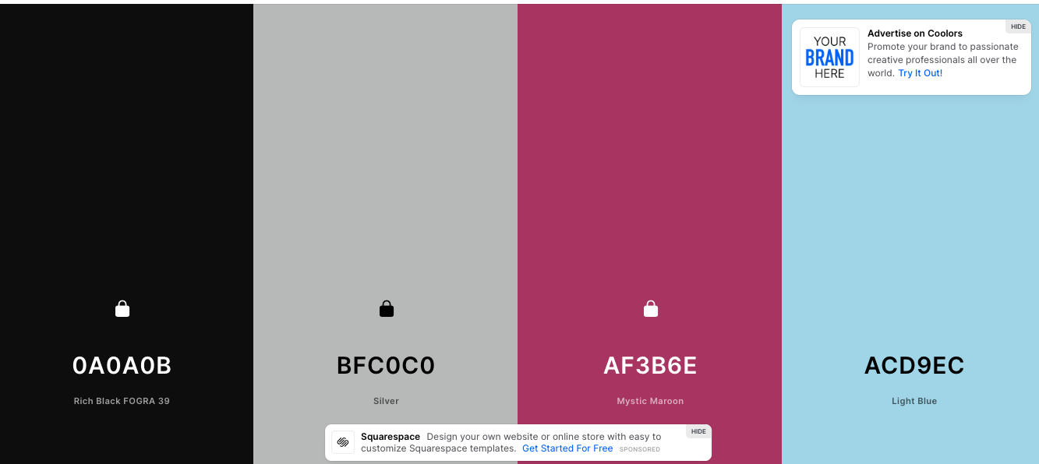
PRODUCT OWNER VISION
Colour Scheme

Slide 14

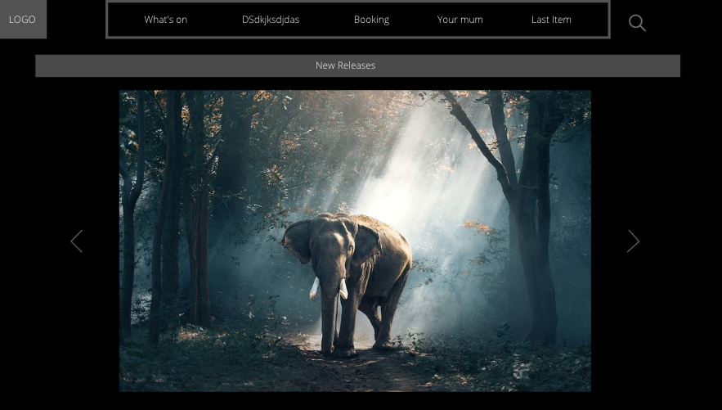
PRODUCT OWNER VISION
Consistent
Cohesive
Minimalistic / clean

Slide 15
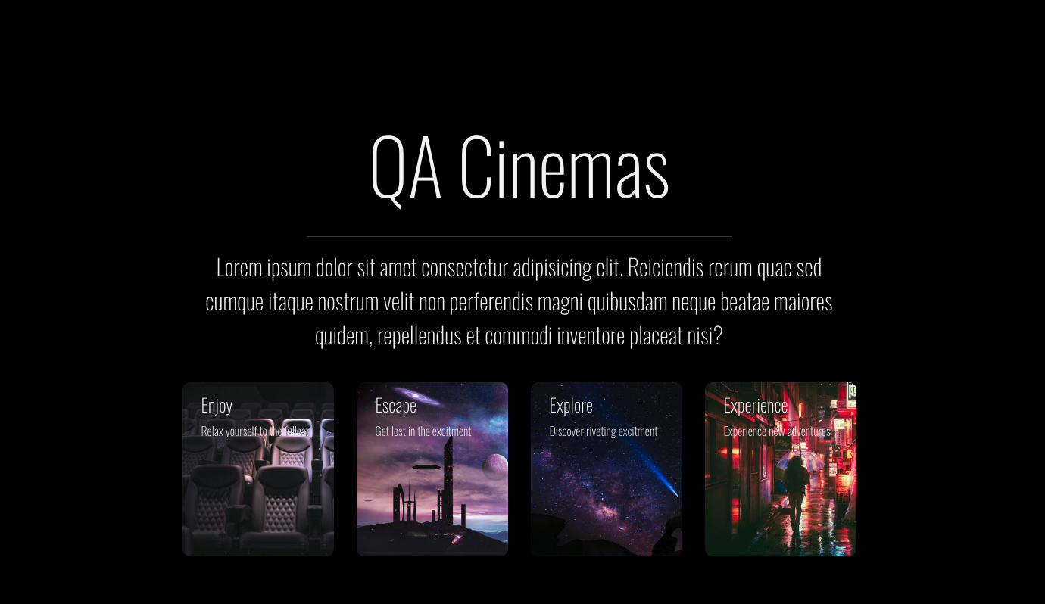
PRODUCT OWNER VISION
Figuring out main colours and font, building the rest of design based on that.
Consistent
Cohesive
Minimalistic / clean

Slide 16



REFLECTION
Firstly, I believe every member in this team has played their part to get the best possible outcome for this project.in addition we came across issues which allowed us to enhance our problem solving capability, learning to communicate more often as we was having issues with GitHub as members were not pushing work more frequently and loss of time as we were resolving merge conflicts. We also had discussions about using Jira ticket function effectively as members were doing the same tasks. After a brief period of mishaps we got more organized, the structure of the team start to show as the front end team started to mould their work to the project owners image. The backend team had challenging moments specially with testing all codes before deployment. Unfortunately we could not complete the booking seat feature. Overall we are extremely happy with the outcome of our project.

